Slide 1

TCP: Overview RFCs: 793, 1122, 1323, 2018, 2581
point-to-point:
  one sender, one receiver
reliable, in-order byte steam:
  no “message boundaries”
pipelined:
  TCP congestion and flow control set window size
send & receive buffers
full duplex data:
  bi-directional data flow in same connection
  MSS: maximum segment size
connection-oriented:
  handshaking (exchange of control msgs) init’s sender, receiver state before data exchange
flow controlled:
  sender will not overwhelm receiver
3: Transport Layer
3b-<number>

Slide 2
TCP segment structure
32 bits
URG: urgent data
(generally not used)
counting
by bytes
of data
(not segments!)
source port #
dest port #
sequence number
ACK: ACK #
valid
acknowledgement number
head
len
not
used
U
rcvr window size
A
PSH: push data now
(generally not used)
P
R
S
F
# bytes
rcvr willing
to accept
checksum
ptr urgent data
RST, SYN, FIN:
connection estab
(setup, teardown
commands)
Options (variable length)
application
data
(variable length)
Internet
checksum
(as in UDP)
3: Transport Layer
3b-<number>

Slide 3

TCP seq. #’s and ACKs
Seq. #’s:
  byte stream “number” of first byte in segment’s data
ACKs:
  seq # of next byte expected from other side
  cumulative ACK
Q: how receiver handles out-of-order segments
  A: TCP spec doesn’t say, - up to implementor
Host A
Host B
User
types
‘C’
Seq=42, ACK=79, data = ‘C’
host ACKs
receipt of
‘C’, echoes
back ‘C’
Seq=79, ACK=43, data = ‘C’
host ACKs
receipt
of echoed
‘C’
Seq=43, ACK=80
time
simple telnet scenario
3: Transport Layer
3b-<number>

Slide 4
TCP: reliable data transfer
event: data received
from application above
simplified sender, assuming
create, send segment
one way data transfer
no flow, congestion control
wait
for
event
event: timer timeout for
segment with seq # y
wait
for
event
retransmit segment
event: ACK received,
with ACK # y
ACK processing
3: Transport Layer
3b-<number>

Slide 5
TCP: reliable data transfer
00 sendbase = initial_sequence number
01 nextseqnum = initial_sequence number
02
03 loop (forever) {
04 switch(event)
05 event: data received from application above
06 create TCP segment with sequence number nextseqnum
07 start timer for segment nextseqnum
08 pass segment to IP
09 nextseqnum = nextseqnum + length(data)
10 event: timer timeout for segment with sequence number y
11 retransmit segment with sequence number y
12 compue new timeout interval for segment y
13 restart timer for sequence number y
14 event: ACK received, with ACK field value of y
15 if (y > sendbase) { /* cumulative ACK of all data up to y */
16 cancel all timers for segments with sequence numbers < y
17 sendbase = y
18 }
19 else { /* a duplicate ACK for already ACKed segment */
20 increment number of duplicate ACKs received for y
21 if (number of duplicate ACKS received for y == 3) {
22 /* TCP fast retransmit */
23 resend segment with sequence number y
24 restart timer for segment y
25 }
26 } /* end of loop forever */
Simplified
TCP
sender
3: Transport Layer
3b-<number>

Slide 6
TCP ACK generation [RFC 1122, RFC 2581]
Event
in-order segment arrival,
no gaps,
everything else already ACKed
in-order segment arrival,
no gaps,
one delayed ACK pending
out-of-order segment arrival
higher-than-expect seq. #
gap detected
arrival of segment that
partially or completely fills gap
TCP Receiver action
delayed ACK. Wait up to 500ms
for next segment. If no next segment,
send ACK
immediately send single
cumulative ACK
send duplicate ACK, indicating seq. #
of next expected byte
immediate ACK if segment starts
at lower end of gap
3: Transport Layer
3b-<number>

Slide 7
TCP: retransmission scenarios
Host A
Host B
Host A
Host B
Seq=92, 8 bytes data
Seq=92, 8 bytes data
Seq=100, 20 bytes data
timeout
ACK=100
Seq=92 timeout
X
ACK=100
Seq=100 timeout
ACK=120
loss
Seq=92, 8 bytes data
Seq=92, 8 bytes data
ACK=120
ACK=100
time
time
premature timeout,
cumulative ACKs
lost ACK scenario
3: Transport Layer
3b-<number>

Slide 8

TCP Flow Control
flow control
receiver: explicitly informs sender of (dynamically changing) amount of free buffer space
  RcvWindow field in TCP segment
sender: keeps the amount of transmitted, unACKed data less than most recently received RcvWindow
sender won’t overrun
receiver’s buffers by
transmitting too much,
too fast
RcvBuffer = size or TCP Receive Buffer
RcvWindow = amount of spare room in Buffer
receiver buffering
3: Transport Layer
3b-<number>

Slide 9
TCP Round Trip Time and Timeout
Q: how to set TCP timeout value?
longer than RTT
  note: RTT will vary
too short: premature timeout
  unnecessary retransmissions
too long: slow reaction to segment loss
Q: how to estimate RTT?
SampleRTT: measured time from segment transmission until ACK receipt
  ignore retransmissions, cumulatively ACKed segments
SampleRTT will vary, want estimated RTT “smoother”
  use several recent measurements, not just current SampleRTT
3: Transport Layer
3b-<number>

Slide 10
TCP Round Trip Time and Timeout
EstimatedRTT = (1-x)*EstimatedRTT + x*SampleRTT
Exponential weighted moving average
influence of given sample decreases exponentially fast
typical value of x: 0.1
Setting the timeout
EstimtedRTT plus “safety margin”
large variation in EstimatedRTT -> larger safety margin
Timeout = EstimatedRTT + 4*Deviation
Deviation = (1-x)*Deviation +
x*|SampleRTT-EstimatedRTT|
3: Transport Layer
3b-<number>

Slide 11
TCP Connection Management
Recall: TCP sender, receiver establish “connection” before exchanging data segments
initialize TCP variables:
  seq. #s
  buffers, flow control info (e.g. RcvWindow)
client: connection initiator
Socket clientSocket = new Socket("hostname","port number");
server: contacted by client
Socket connectionSocket = welcomeSocket.accept();
Three way handshake:
Step 1: client end system sends TCP SYN control segment to server
  specifies initial seq #
Step 2: server end system receives SYN, replies with SYNACK control segment
  ACKs received SYN
  allocates buffers
  specifies server-> receiver initial seq. #
3: Transport Layer
3b-<number>

Slide 12
TCP Connection Management (cont.)
Closing a connection:
client closes socket: clientSocket.close();
Step 1: client end system sends TCP FIN control segment to server
Step 2: server receives FIN, replies with ACK. Closes connection, sends FIN.
client
server
close
FIN
ACK
close
FIN
ACK
timed wait
closed
3: Transport Layer
3b-<number>

Slide 13
TCP Connection Management (cont.)
Step 3: client receives FIN, replies with ACK.
  Enters “timed wait” - will respond with ACK to received FINs
Step 4: server, receives ACK. Connection closed.
Note: with small modification, can handly simultaneous FINs.
client
server
closing
FIN
ACK
closing
FIN
ACK
timed wait
closed
closed
3: Transport Layer
3b-<number>

Slide 14


TCP Connection Management (cont)
TCP server
lifecycle
TCP client
lifecycle
3: Transport Layer
3b-<number>

Slide 15
Principles of Congestion Control
Congestion:
informally: “too many sources sending too much data too fast for network to handle”
different from flow control!
manifestations:
  lost packets (buffer overflow at routers)
  long delays (queueing in router buffers)
a top-10 problem!
3: Transport Layer
3b-<number>

Slide 16
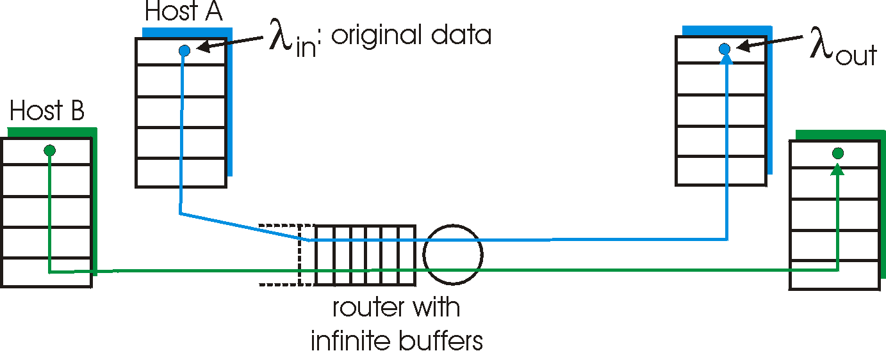

Causes/costs of congestion: scenario 1
two senders, two receivers
one router, infinite buffers
no retransmission
large delays when congested
maximum achievable throughput
3: Transport Layer
3b-<number>

Slide 17
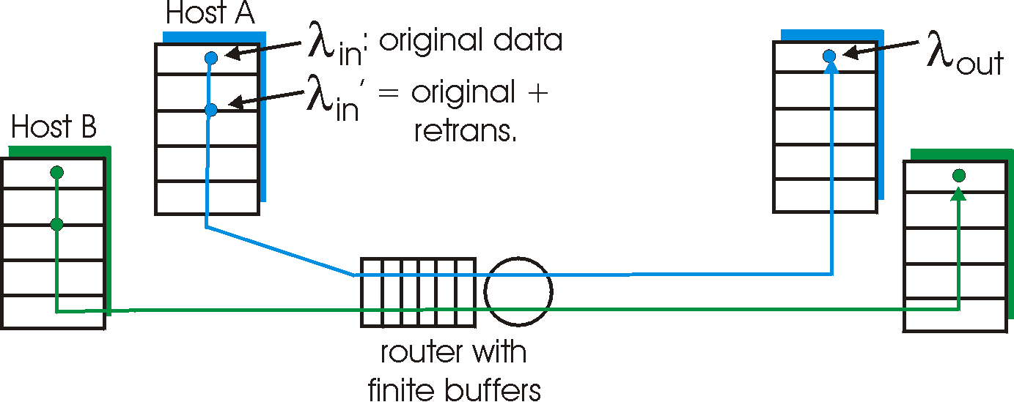
Causes/costs of congestion: scenario 2
one router, finite buffers
sender retransmission of lost packet
3: Transport Layer
3b-<number>

Slide 18
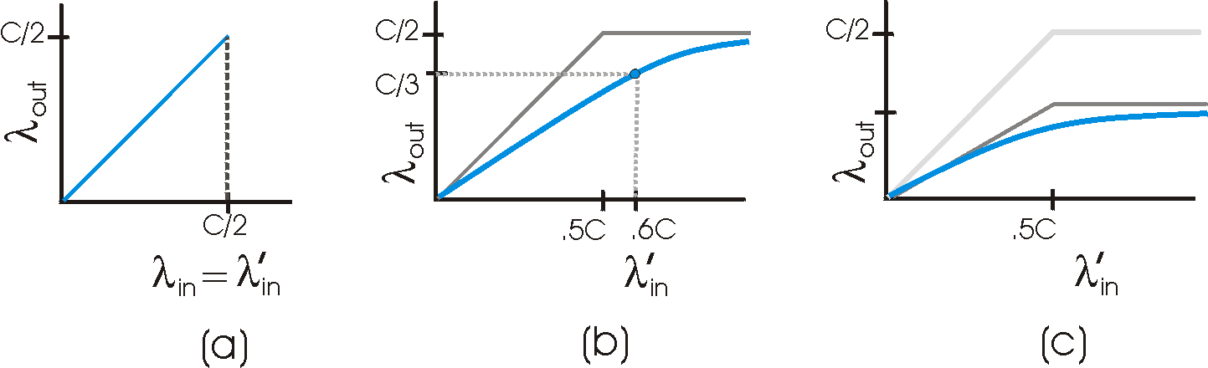
Causes/costs of congestion: scenario 2
λ
=
λ
always: (goodput)
“perfect” retransmission only when loss:
retransmission of delayed (not lost) packet makes larger (than perfect case) for same
in
out
λ
>
λ
in
out
λ
λ
in
out
“costs” of congestion:
more work (retrans) for given “goodput”
unneeded retransmissions: link carries multiple copies of pkt
3: Transport Layer
3b-<number>

Slide 19
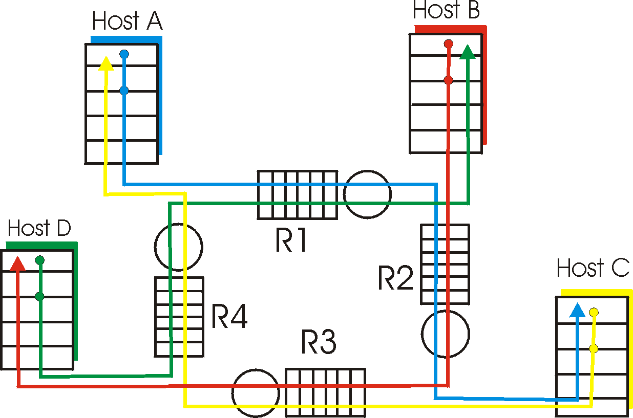
Causes/costs of congestion: scenario 3
λ
four senders
multihop paths
timeout/retransmit
Q: what happens as and increase ?
λ
in
in
3: Transport Layer
3b-<number>

Slide 20

Causes/costs of congestion: scenario 3
Another “cost” of congestion:
when packet dropped, any “upstream transmission capacity used for that packet was wasted!
3: Transport Layer
3b-<number>

Slide 21
Approaches towards congestion control
Two broad approaches towards congestion control:
End-end congestion control:
no explicit feedback from network
congestion inferred from end-system observed loss, delay
approach taken by TCP
Network-assisted congestion control:
routers provide feedback to end systems
  single bit indicating congestion (SNA, DECbit, TCP/IP ECN, ATM)
  explicit rate sender should send at
3: Transport Layer
3b-<number>

Slide 22
Case study: ATM ABR congestion control
ABR: available bit rate:
“elastic service”
if sender’s path “underloaded”:
  sender should use available bandwidth
if sender’s path congested:
  sender throttled to minimum guaranteed rate
RM (resource management) cells:
sent by sender, interspersed with data cells
bits in RM cell set by switches (“network-assisted”)
  NI bit: no increase in rate (mild congestion)
  CI bit: congestion indication
RM cells returned to sender by receiver, with bits intact
3: Transport Layer
3b-<number>

Slide 23

Case study: ATM ABR congestion control
two-byte ER (explicit rate) field in RM cell
  congested switch may lower ER value in cell
  sender’ send rate thus minimum supportable rate on path
EFCI bit in data cells: set to 1 in congested switch
  if data cell preceding RM cell has EFCI set, sender sets CI bit in returned RM cell
3: Transport Layer
3b-<number>

Slide 24

TCP Congestion Control
end-end control (no network assistance)
transmission rate limited by congestion window size, Congwin, over segments:
Congwin
w segments, each with MSS bytes sent in one RTT:
w * MSS
throughput =
Bytes/sec
RTT
3: Transport Layer
3b-<number>

Slide 25
TCP congestion control:
“probing” for usable bandwidth:
  ideally: transmit as fast as possible (Congwin as large as possible) without loss
  increase Congwin until loss (congestion)
  loss: decrease Congwin, then begin probing (increasing) again
two “phases”
  slow start
  congestion avoidance
important variables:
  Congwin
  threshold: defines threshold between two slow start phase, congestion control phase
3: Transport Layer
3b-<number>

Slide 26
TCP Slowstart
Host A
Host B
Slowstart algorithm
one segment
initialize: Congwin = 1
for (each segment ACKed)
Congwin++
until (loss event OR
CongWin > threshold)
RTT
two segments
four segments
exponential increase (per RTT) in window size (not so slow!)
loss event: timeout (Tahoe TCP) and/or or three duplicate ACKs (Reno TCP)
time
3: Transport Layer
3b-<number>

Slide 27
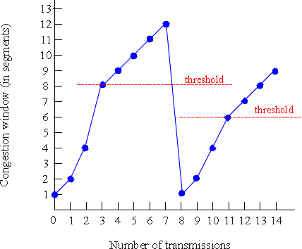
TCP Congestion Avoidance
Congestion avoidance
/* slowstart is over */
/* Congwin > threshold */
Until (loss event) {
every w segments ACKed:
Congwin++
}
threshold = Congwin/2
Congwin = 1
perform slowstart
1
1: TCP Reno skips slowstart (fast
recovery) after three duplicate ACKs
3: Transport Layer
3b-<number>

Slide 28
TCP Fairness
AIMD
TCP congestion avoidance:
AIMD: additive increase, multiplicative decrease
  increase window by 1 per RTT
  decrease window by factor of 2 on loss event
Fairness goal: if N TCP sessions share same bottleneck link, each should get 1/N of link capacity
TCP connection 1
TCP
connection 2
bottleneck
router
capacity R
3: Transport Layer
3b-<number>

Slide 29
Why is TCP fair?
Two competing sessions:
Additive increase gives slope of 1, as throughout increases
multiplicative decrease decreases throughput proportionally
R
equal bandwidth share
loss: decrease window by factor of 2
congestion avoidance: additive increase
Connection 2 throughput
loss: decrease window by factor of 2
congestion avoidance: additive increase
Connection 1 throughput
R
3: Transport Layer
3b-<number>

Slide 30
TCP latency modeling
Q: How long does it take to receive an object from a Web server after sending a request?
TCP connection establishment
data transfer delay
Notation, assumptions:
Assume one link between client and server of rate R
Assume: fixed congestion window, W segments
S: MSS (bits)
O: object size (bits)
no retransmissions (no loss, no corruption)
Two cases to consider:
WS/R > RTT + S/R: ACK for first segment in window returns before window’s worth of data sent
WS/R < RTT + S/R: wait for ACK after sending window’s worth of data sent
3: Transport Layer
3b-<number>

Slide 31
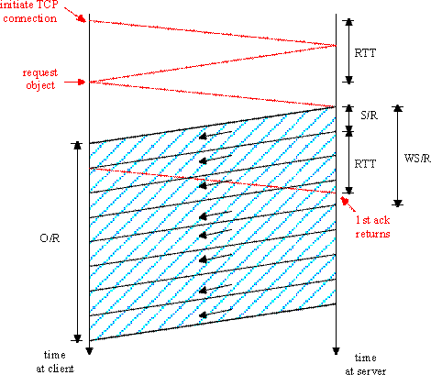
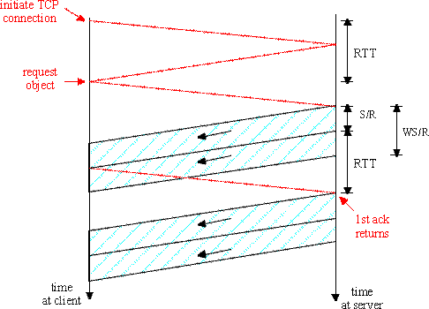
TCP latency Modeling
K:= O/WS
Case 1: latency = 2RTT + O/R
Case 2: latency = 2RTT + O/R
+ (K-1)[S/R + RTT - WS/R]
3: Transport Layer
3b-<number>

Slide 32
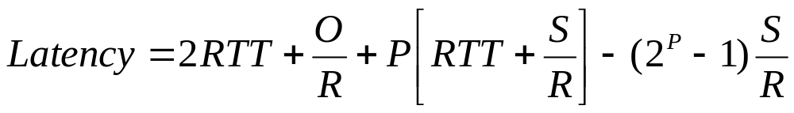

TCP Latency Modeling: Slow Start
Now suppose window grows according to slow start.
Will show that the latency of one object of size O is:
where P is the number of times TCP stalls at server:
- where Q is the number of times the server would stall
if the object were of infinite size.
- and K is the number of windows that cover the object.
3: Transport Layer
3b-<number>

Slide 33
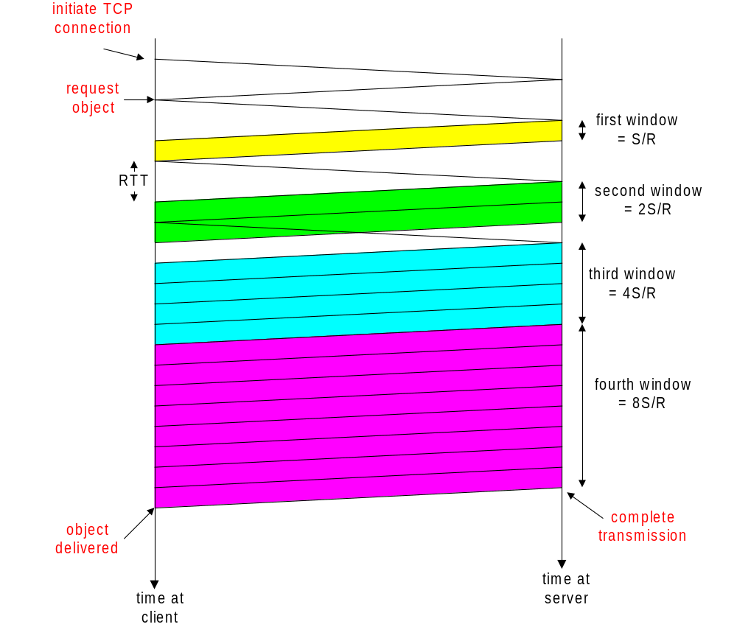
TCP Latency Modeling: Slow Start (cont.)
Example:
O/S = 15 segments
K = 4 windows
Q = 2
P = min{K-1,Q} = 2
Server stalls P=2 times.
3: Transport Layer
3b-<number>

Slide 34
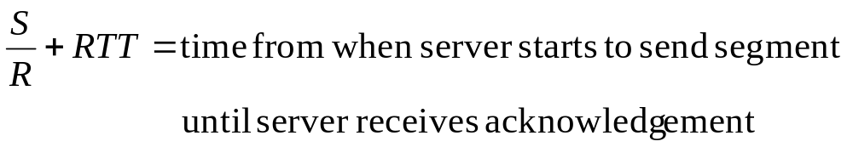
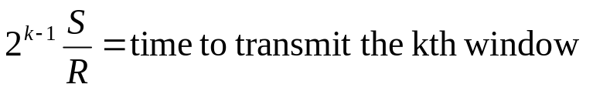
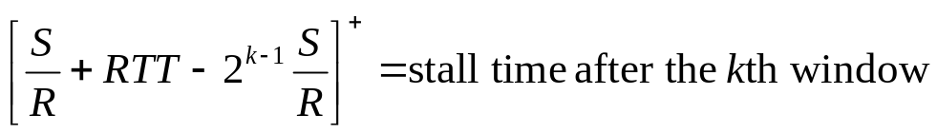
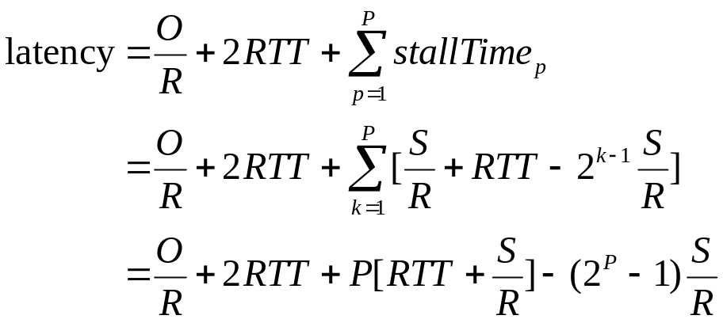
TCP Latency Modeling: Slow Start (cont.)
3: Transport Layer
3b-<number>

Slide 35
Chapter 3: Summary
principles behind transport layer services:
  multiplexing/demultiplexing
  reliable data transfer
  flow control
  congestion control
instantiation and implementation in the Internet
  UDP
  TCP
Next:
leaving the network “edge” (application transport layer)
into the network “core”
3: Transport Layer
3b-<number>

